Slide 1
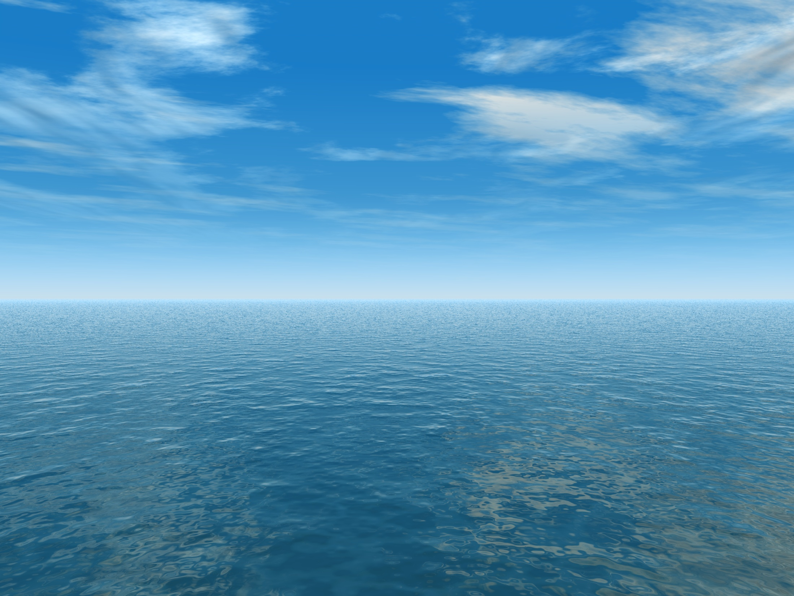
THE AQUANTIS OCEAN-CURRENT TURBINE
RENEWABLE ENERGY FROM MARINE CURRENTS
1/25th Scale Rotor Off-Design
March 28, 2013
Henry Swales
Company Confidential and Proprietary

Slide 2
Off-Design Comparisons (1.9m/s)
TSR=6 is minimum computed with test data.
Lower values use Viterna flat-plate approximation for post-stall performance.
Thrust diverges from scaled values at TSR above design point.
Only test cases that experience TSR above 8.0 are hydraulic failures.
Differences in off-design performance result from hydrofoil, Re#, and AoA differences.
See next slide and previous hydrofoil polar data plots.
Adjust blade pitch and/or TSR to improve thrust accuracy for off-design cases based on results of captured test.

Slide 3
Thrust Calibration by Pitch Adjustment
Zero-torque thrust matches very well at -2deg model blade pitch.
Zero-torque model TSR is slightly less at -2deg blade pitch.

